Slide 1
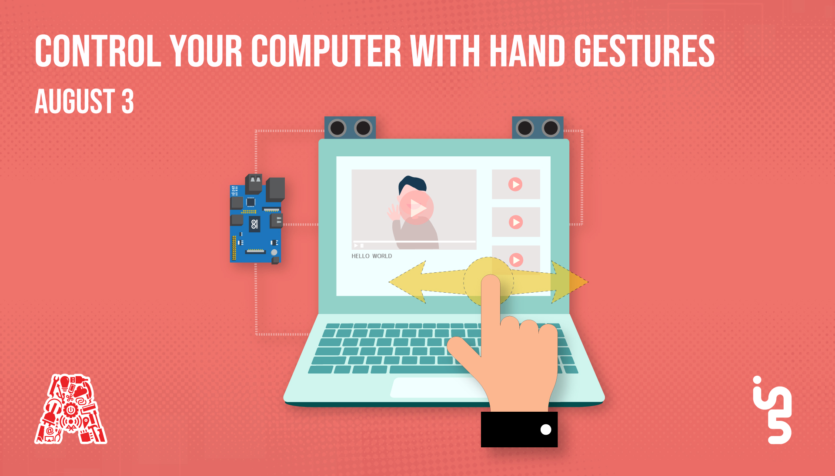

Slide 2
About the Assembly
A smart lab based out of In5 since Dec 2014
Over 250 free workshops done
ASSEMBLY: HACK - Embedded systems, iOT and hardware
ASSEMBLY: CODE - Software projects - APIs, frameworks, apps
Age range: 16-60 - students, professionals, entrepreneurs
Focus on smart technology and practical applications
Forum: members.theassembly.ae

Slide 3
TAG US ON OUR SOCIAL MEDIA
FACEBOOK
TWITTER
INSTAGRAM
YOUTUBE
The Assembly (@MakeSmartThings)
@MakeSmartThings
@MakeSmartThings
The Assembly

Slide 4
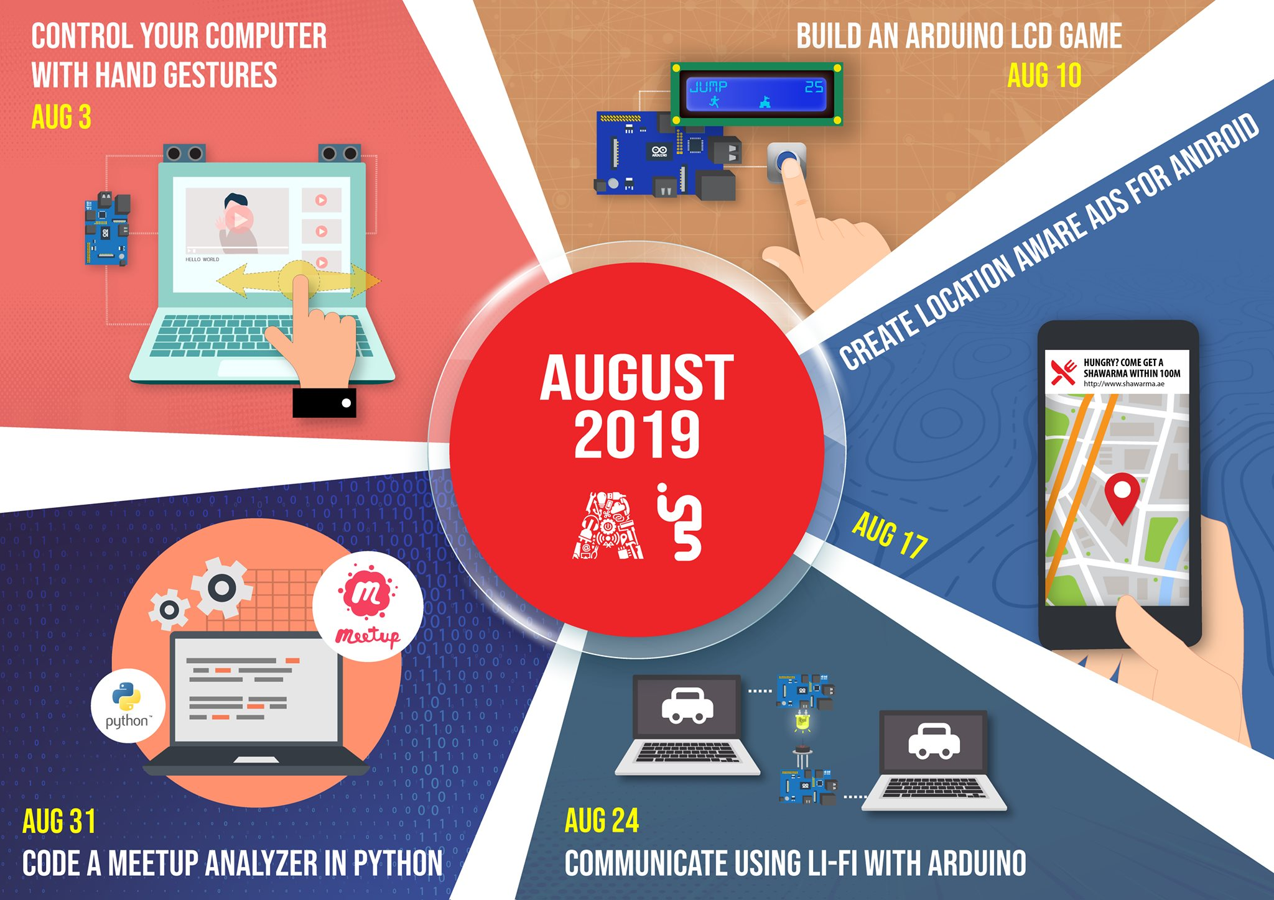

Slide 5
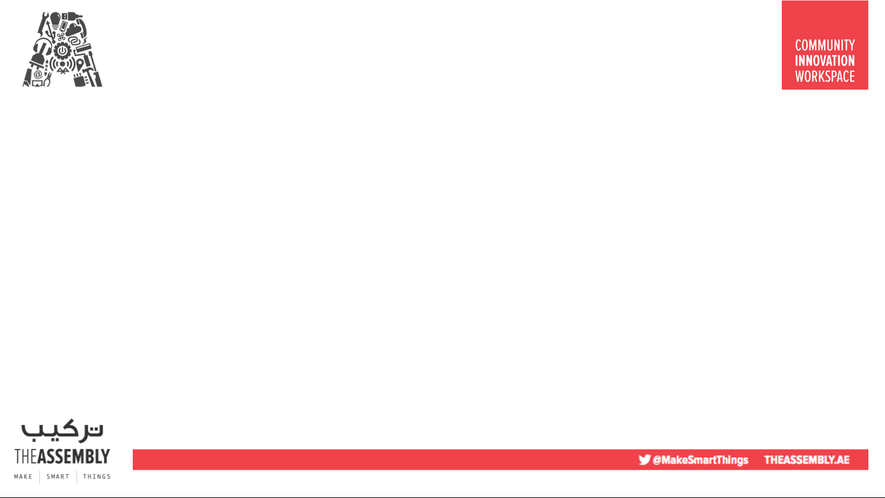

Overview
TOPICS:
Hand gesture recognition
Ultrasonic sensors
PyAutoGui
Setting up Pyautogui
Task I – Hardware assembly
Task II – Handsfree Video Control
Task III – Handsfree browser control

Slide 6


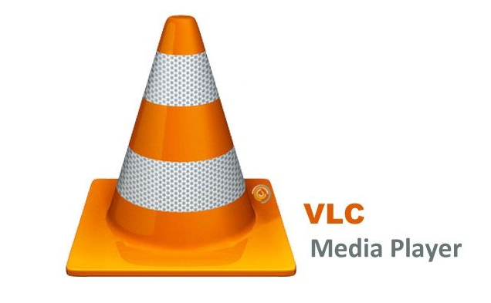
Dependencies
Software:
Anaconda https://www.anaconda.com/distribution/#download-section
Arduino IDE https://www.arduino.cc/en/main/software
Video Software:
VLC https://www.videolan.org/vlc/
Code files:
https://github.com/The-Assembly/hands_gestures
WIFI: WelcomeToIn5

Slide 7
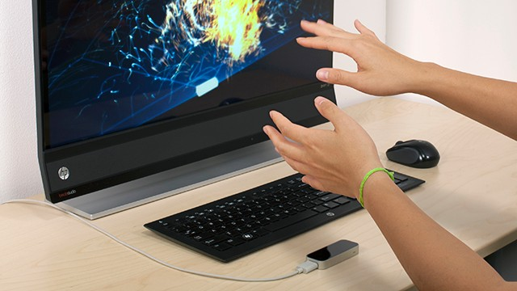
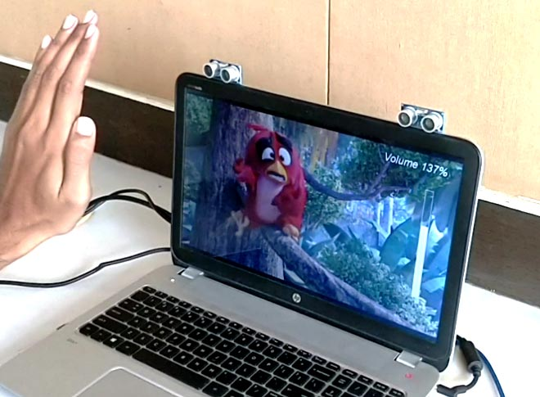
Hand Gesture recognition
Gesture controlled Laptops or computers are getting very famous. Hand gesture recognition can use various techniques that enables us to control certain functions on our computer/Laptop by simply waving our hand in front of it.

Slide 8

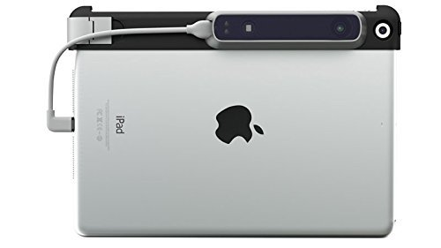
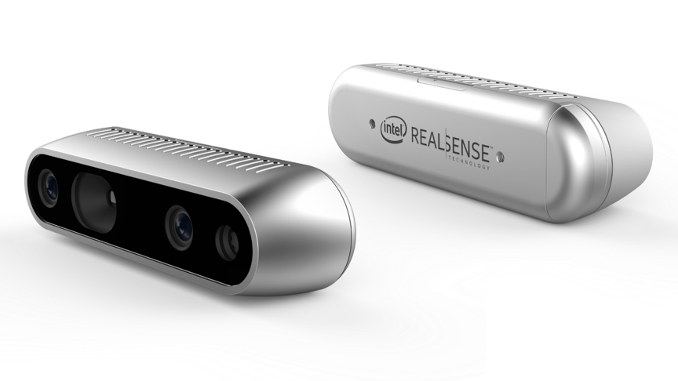
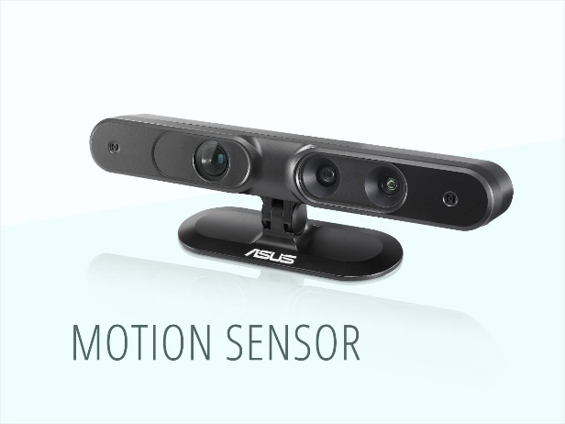
Hand Gesture Recognition and Control
Applications:
Automotive sector
Consumer electronics sector
Transit sector
Gaming sector
To unlock smartphones
Defense
Home automation
Automated sign language translation
Examples:
Structure Sensor
Intel RealSense
Orbbec3D
Asus Xtion
Leap Motion

Slide 9
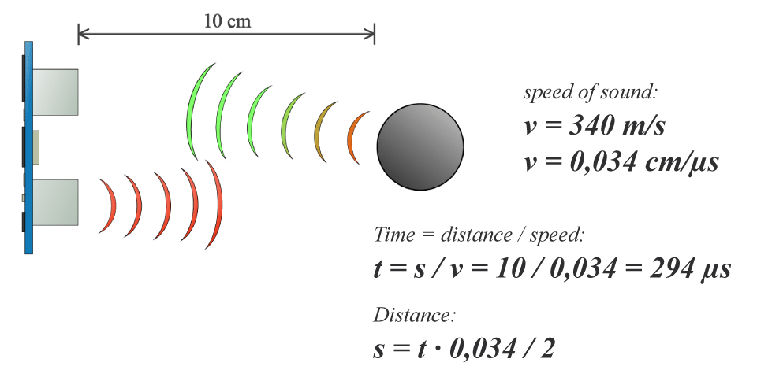
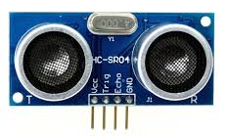
Ultrasonic sensors
Ultrasonic sensors are a type of acoustic sensor divided into three broad categories: transmitters, receivers and transceivers. Ultrasonic sensors measure distance by using ultrasonic waves. The sensor head emits an ultrasonic wave and receives the wave reflected back from the target. Ultrasonic Sensors measure the distance to the target by measuring the time between the emission and reception.
Notes:
It is not just a 3D scene graph or a mark-up language; the core is a powerful entity-component framework that provides a declarative, extensible, and composable structure to three.js(cross-browser JavaScript library and Application Programming Interface (API) used to create and display animated 3D computer graphics in a web browser) .

Slide 10
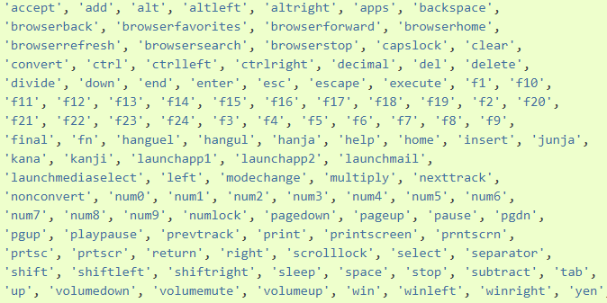
What is pyautogui?
PyAutoGUI is a cross-platform GUI automation Python module for human beings. Used to programmatically control the mouse & keyboard.
https://pyautogui.readthedocs.io/en/latest/keyboard.html

Slide 11
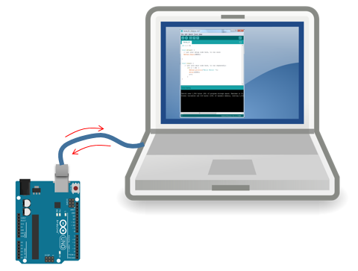
Serial communication – Arduino and Python
Serial is used for communication between the Arduino board and a computer or other devices. All Arduino boards have at least one serial port (also known as a UART or USART): Serial. It communicates on digital pins 0 (RX) and 1 (TX) as well as with the computer via USB.
pySerial is a Python API module to access the serial port. pySerial provides a uniform API across multiple operating systems, including Windows, Linux, and BSD.

Slide 12
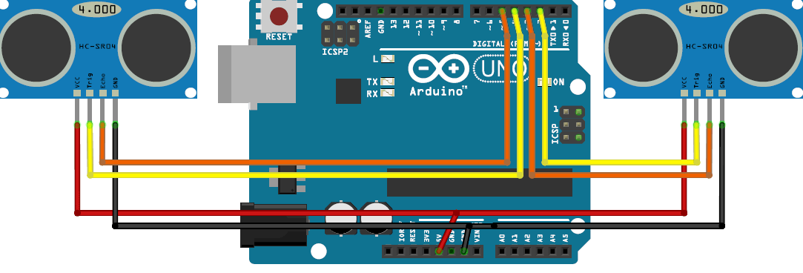
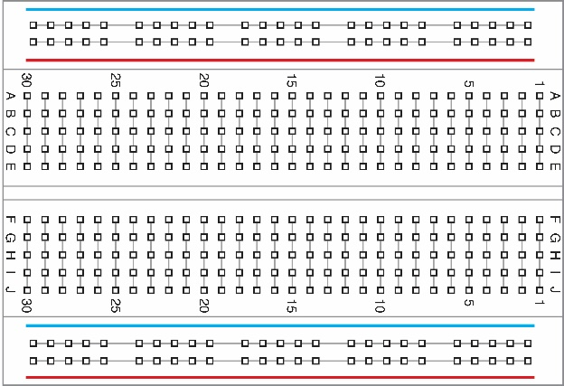


Task I – Assembly and set up of Hardware
Connections:
Trigger 1 - pin 4
Echo 1 - pin 5
Trigger 2 - pin 2
Echo 2 - pin 3
Connections of the ultrasonic sensors to the Arduino Uno

Slide 13
Task II – Handsfree Video Control
Launch Arduino IDE
Create a new file
Declare the pins of the ultrasonic sensors:
const int trigger1 = 2; //Trigger pin of 1st Sesnor
const int echo1 = 3; //Echo pin of 1st Sesnor
const int trigger2 = 4; //Trigger pin of 2nd Sesnor
const int echo2 = 5;//Echo pin of 2nd Sesnor
Initialize the pins:
void setup() {
Serial.begin(9600);
pinMode(trigger1, OUTPUT);
pinMode(echo1, INPUT);
pinMode(trigger2, OUTPUT);
pinMode(echo2, INPUT); }

Slide 14
Task II – Handsfree Video Control
Function to calculate distance between sensor and hands
void calculate_distance(int trigger, int echo)
{
digitalWrite(trigger, LOW);
delayMicroseconds(2);
digitalWrite(trigger, HIGH);
delayMicroseconds(10);
digitalWrite(trigger, LOW);
time_taken = pulseIn(echo, HIGH);
dist= time_taken*40.03/2;
if (dist>50)
dist = 50;
}

Slide 15
Task II – Handsfree Video Control
Main loop for sensing hand gestures
void loop() { calculate_distance(trigger1,echo1);
distL =dist; //get distance of left sensor
calculate_distance(trigger2,echo2);
distR =dist; //get distance of right sensor
delay(200);
}

Slide 16
Task II – Handsfree Video Control
Defining distances between sensor and hand to assign functionality
//Pause Modes -Hold
if ((distL >40 && distR>40) && (distL <50 && distR<50)) //Detect both hands
{Serial.println("Play/Pause"); delay (500);}
if ((distL >0 && distR>0) && (distL <5 && distR<5)) //Detect both hands
{Serial.println ("MUTE"); delay ( 500);}
calculate_distance(trigger1,echo1);
distL =dist;
calculate_distance(trigger2,echo2);
distR =dist;

Slide 17
Task II – Handsfree Video Control
//Control Modes
//Lock Left - Control Mode
if (distL>=13 && distL<=17)
{
delay(100); //Hand Hold Time
calculate_distance(trigger1,echo1);
distL =dist;
if (distL>=13 && distL<=17)
{
Serial.println("Left Locked");
while(distL<=40)
{
calculate_distance(trigger1,echo1);
distL =dist;
if (distL<10) //Hand pushed in
{Serial.println ("Vdown"); delay (500);}
if (distL>20) //Hand pulled out
{Serial.println ("Vup"); delay (500);}
}
}
}
Defining distances between sensor and hand to assign functionality
Detection of a single hand within a defined distance range

Slide 18
Task II – Handsfree Video Control
//Lock Right - Control Mode
if (distR>=13 && distR<=17)
{
delay(100); //Hand Hold Time
calculate_distance(trigger2,echo2);
distR =dist;
if (distR>=13 && distR<=17)
{
Serial.println("Right Locked");
while(distR<=40)
{
calculate_distance(trigger2,echo2);
distR =dist;
if (distR<10) //Right hand pushed in
{Serial.println ("Rewind"); delay (300);}
if (distR>20) //Right hand pulled out
{Serial.println ("Forward"); delay (300);}
}
}
}
Detection of a left hand within a defined distance range

Slide 19
Task II – Handsfree Video Control
For windows:
Open Anaconda Command prompt and use the command to install the pyautogui module
“python –m pip install pyautogui”
For Mac:
Launch Anaconda
Execute the following code on the terminal:
pip install --upgrade pip
conda install -c conda-forge pyautoguipip
install pyserial
3)To find the port addresses on a mac use the terminal command:
python -m serial.tools.list_ports

Slide 20

Task II – Handsfree Video Control
Download pyserial library in Anaconda
Launch Spyder (Python 3.7)
Create a new .py file
Import libraries: -import serial
-import time
-import pyautogui
Create a Serial port object for Arduino connection:
ArduinoSerial = serial.Serial (‘USB PORT’,9600)

Slide 21
Task II – Handsfree Video Control
while 1:
incoming = str (ArduinoSerial.readline())
print (incoming)
if 'Play/Pause' in incoming:
pyautogui.typewrite(['space'], 0.2)
if 'Vup' in incoming:
pyautogui.hotkey('ctrl', 'up')
if 'Vdown' in incoming:
pyautogui.hotkey('ctrl',' down ' )
incoming = "";
Main loop for reading and writing instructions to and from the Arduino and your computer using “pyautogui”

Slide 22
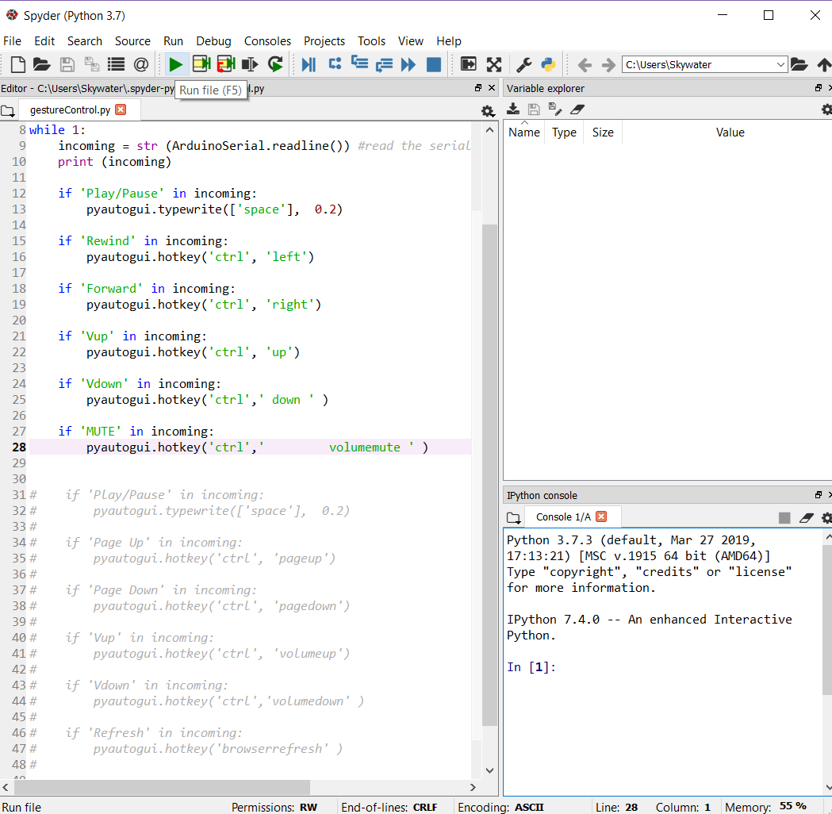
Task II – Handsfree Video Control
Run the python file
Play a video using VLC player
Test hand gesture control

Slide 23
Task III – Handsfree Browser Control
Using pyautogui shortcuts for the keyboard, define new functionality to control browser operation
Refresh a browser using ‘browserrefresh’ command with hotkey() in the .py code
if 'Refresh' in incoming:
pyautogui.hotkey('browserrefresh' )
And the following update in the Arduino code for hand detection
//if ((distL >0 && distR>0) && (distL <5 && distR<5)) //Detect both hands
//{Serial.println ("Refresh"); delay ( 500);}

Slide 24
THANK YOU!
Credits to: Aswinth Raj
https://circuitdigest.com/microcontroller-projects/control-your-computer-with-hand-gestures

